Slide 1
The Stock Market as A Movie
Lei Yao

Slide 2
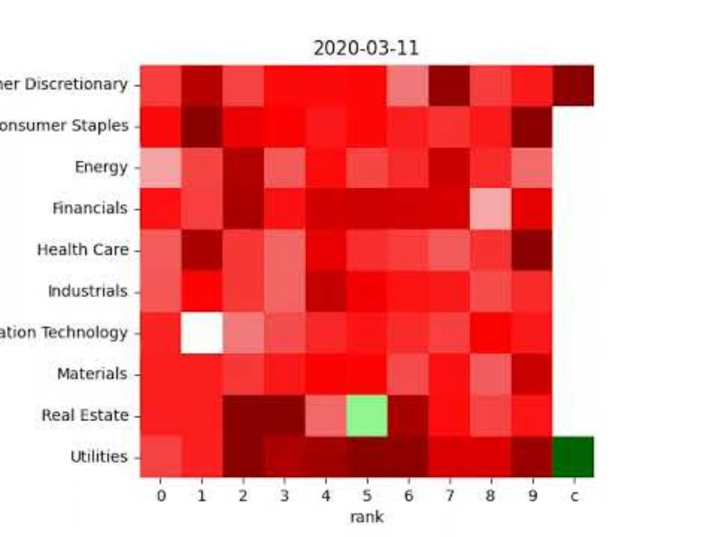
INTRODUCTION
To use Deep Learning as a tool to combine domain knowledge with ML/AL models
Arrange stocks in orders to allow model to extract information
10 stocks pick from each sector in SP500, 10 years history
x-sector, y-marketcap

Slide 3
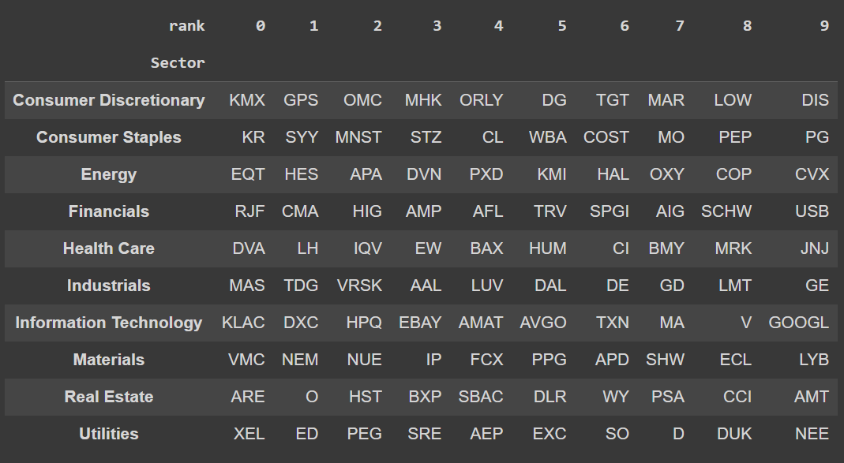
The Experiment
10 stocks pick from each sector in SP500, 10 years history
y-sector, x-marketcap
Train:7 years, Test:3 years

Slide 4
Two Models
Baseline:
2 Layers of Dense
Number params ~15k
CNN:
2 Layers of Conv2D+MaxPool
2 Layers of Dense
Number params ~15k

Slide 5
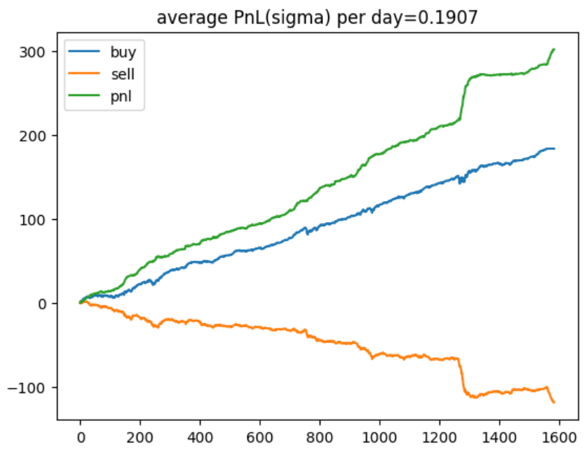
The BackTest
Use the past n days (frames) to predict tomorrow’s stock return, in the unit of standard deviation.
N = 5 or 10
Label as “buy” if prediction > 0 else “sell”.
Pnl = “buy” – “sell”, uniform weights
In sample result, baseline model (n=5):

Slide 6
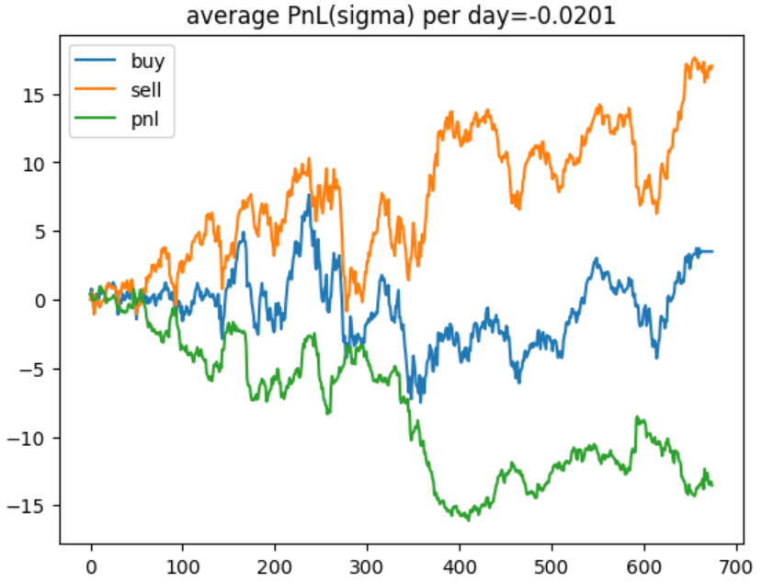
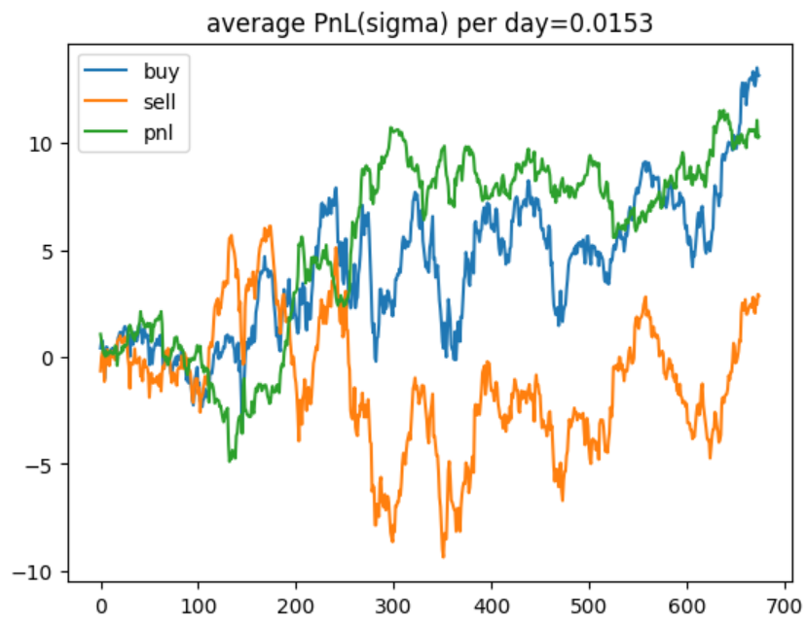
The OOS Results Lookback=5
Baseline
CNN

Slide 7
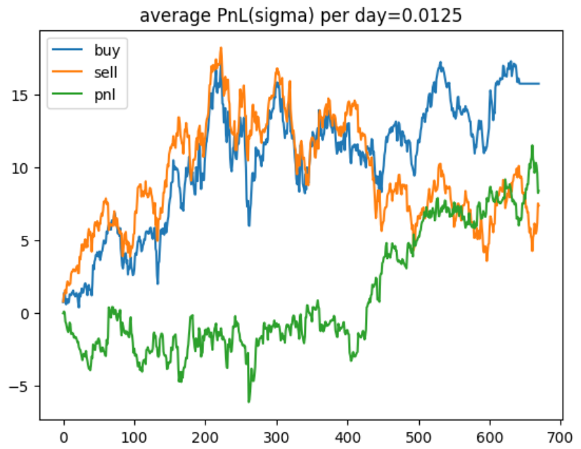
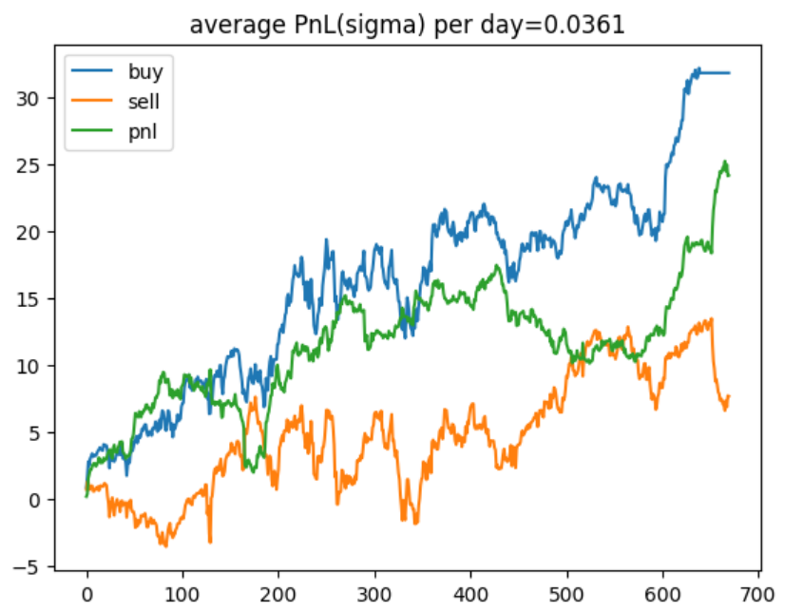
The OOS Results Lookback=10
Baseline
CNN

Slide 8
SUMMARY
Explore the idea of ordering stocks using domain knowledge and using CNN to extract information. Conducted experiment of stocks in SP500 and the results are positive.
Going forward:
More data, different ways to arrange stocks
Autoencoder to extract “market state”

Slide 9
THANK YOU
Lei Yao
mark5907@gmail.com

